Slide 1

MindRise
Classroom Intelligence & Resource Management Platform
NavKalpana — Project Code: RICR-NK-0003
Team : Arunav Kishor
Prateek Raiger
Punit Kishor Paradkar
Pradeep Paswan

Slide 2


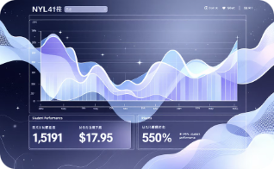
Problem Statement
Schools and colleges today struggle with fragmented, manual workflows: attendance recorded on disparate spreadsheets, assessment
results delayed or lost, and no clear visual metrics to track individual student growth over time. These gaps create administrative
inefficiency and hinder timely academic interventions.
Fragmented
Attendance
Slow Assessment
Tracking
No Visual Growth
Metrics
Manual processes lead to inconsistent records and delayed corrections.
Grading delays, file management issues, and difficulty tracking progress across formats.
Administrators and parents lack clear, actionable views of student development.
Goal: Empower educators with automation and give students a transparent path to improvement through centralized
data and clear visual insights.

Slide 3

Core Features — Admin
Institution-wide Management
Resource Allocation
System Integrity
Unified pane-of-glass to monitor batches, enrollment, staff assignments, and real-time KPIs across the institution.
Dynamic batch scheduling, automated instructor assignment suggestions, and conflict detection to optimize utilization.
Role-based access control (RBAC), detailed audit trails, and administrative dashboards for compliance and accountability.

Slide 4


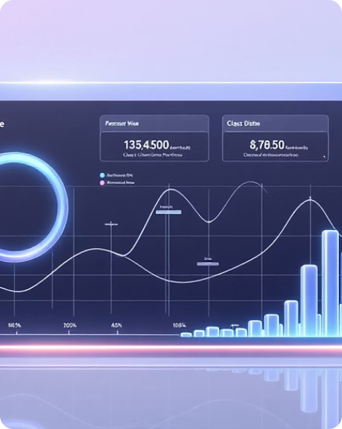

Core Features — Teacher
Attendance 2.0
Assessment Lifecycle
Batch Analytics
Doubt Resolution
Secure marking with a configurable 10-minute edit lock plus same-day validation to maintain record integrity and reduce fraud or accidental edits.
Create, distribute, and grade assignments/exams easily. Supports multi-format uploads (PDF, images) and inline feedback for faster turnaround.
Real-time distribution charts and module-level progress tracking help teachers identify gaps and plan targeted interventions.
Direct messaging channel
with priority handling,
allowing quick clarifications
and structured follow-ups
tied to assignments and
lessons.

Slide 5
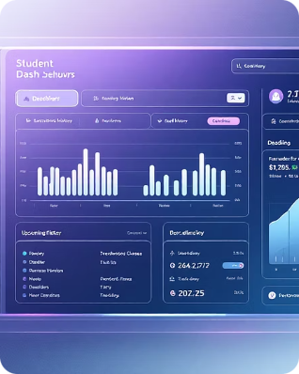

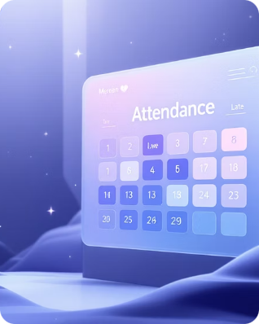
Core Features — Student
Personalized Dashboard
Academic Progress (OGI)
Attendance Transparency
Single view for enrollment history, upcoming deadlines, submission status, and quick links to resources—designed to reduce confusion and missed work.
Overall Growth Index combines attendance and grades into a weighted trend line so learners and advisors can track progress and set measurable goals.
Interactive calendar view with drill-down per day, showing status (Present / Absent / Late) plus notes for excused absences and appeal options.

Slide 6


Technology Stack
Frontend
Backend & Storage
React 19 with Vite for fast builds
Tailwind CSS 4 for utility-driven styling
Framer Motion for smooth UI animations
Recharts for interactive data visualizations
Node.js + Express 5 REST API
JWT authentication with Bcrypt-secured passwords
MongoDB Atlas for scalable cloud database
Cloudinary for media storage (profile photos, assignment files)

Slide 7
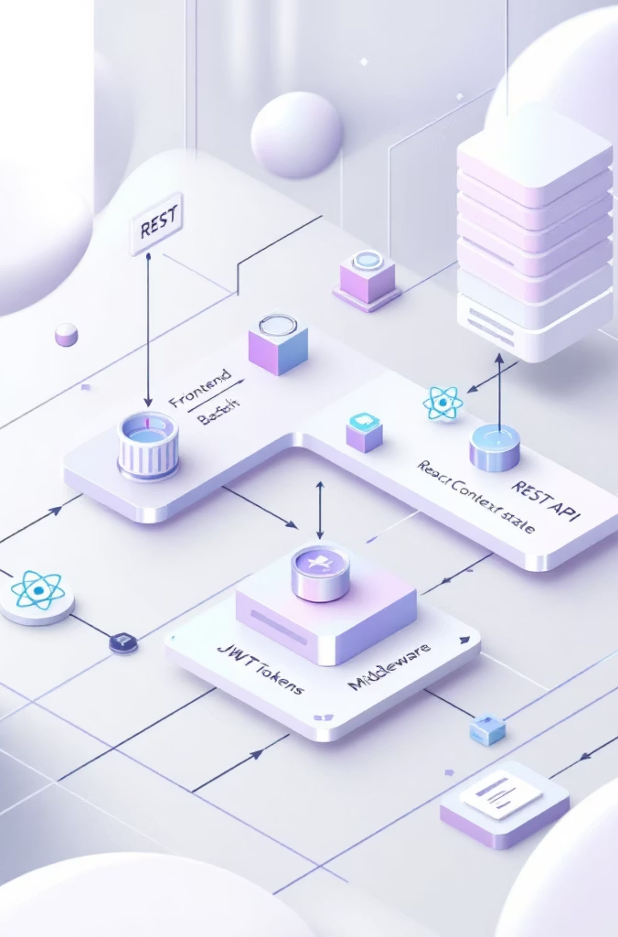

Technical Architecture
MongoDB Atlas & Cloudinary
React Frontend
Data and asset storage
UI and client logic
JWT & Bcrypt
Decoupled MERN Architecture
React Context
Auth tokens and hashing
Client auth state
Middleware Validation
REST API (Node/Express)
Request input checks
Service endpoints
The MERN-based design keeps frontend and backend decoupled for independent scaling. React Context manages authentication state client-side; REST APIs provide clear service boundaries. Security is enforced with Bcrypt and JWT; middleware handles validation and centralized logging for observability and faster debugging.

Slide 8
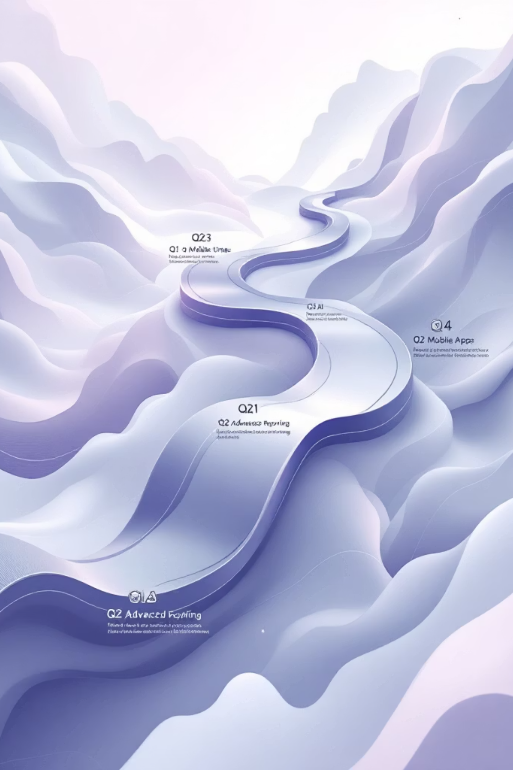
Future Roadmap
1
AI Integration
Predictive models for at-risk students and personalized learning paths; early-warning dashboards for advisors.
2
Real-time Engine
WebSocket-based notifications for instant classroom updates, live doubt queues, and synchronous collaboration features.
3
Mobile Ecosystem
Dedicated Flutter / React Native apps delivering offline access, push notifications, and simplified teacher workflows.
4
Advanced Reporting
Auto-generated PDF report cards, parent-friendly analytics, and exportable insights for institutional audits and accreditation.

Slide 9

Impact & Value Proposition
40%
—
OGI
Admin Efficiency
Transparency
Measurable Growth
Clear student-facing metrics and audit trails that build trust with families and regulators.
Projected reduction in administrative overhead through automation and centralized workflows.
Overall Growth Index (OGI) gives a single, weighted metric to track student progress and intervention effectiveness.
NavKalpana's MindRise platform transforms administrative work into strategic insight — reducing overhead, improving responsiveness, and delivering measurable academic outcomes.

Slide 10


Conclusion & Next Steps
MindRise is more than a dashboard — it's a scalable platform for data-driven education. By combining secure management tools, teacher workflows, and student-facing insights (like the OGI), MindRise reduces administrative load and delivers transparency that helps students succeed.
Pilot Proposal
Partnerships
Measurement
Run a 12-week pilot with one campus to measure time savings, adoption, and OGI movement.
Engage district administrators and potential investors for scaling and integration support.
Track KPIs: admin hours saved, assignment turnaround time, OGI improvements, and parent engagement metrics.
Thank you--

